Slide 1

Welcome to my 1st PowerPoint Presentation

Slide 2
TODAY’S TOPICS
Identity
Name: MD. SHARIFUL ISLAM
I.D- 87,
Batch- E
TOPICS of the DAY
Create a PowerPoint Presentation.
Presentation submit.

Slide 3
We learn How to Create a PowerPoint Presentation
Objectives:
We will learn about PowerPoint.
also learn it’s an Interactive software.
Where we will use PowerPoint?
Advantages of PowerPoint.
Is It important for teachers ?

Slide 4
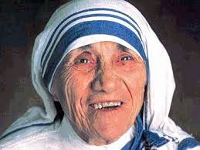
Now We attach picture in the slide
Mother Teresa
Nature

Slide 5
Attachment of Audio & Vedio
Please click the Button
to Hear
Please click VEDIO to see VEDIO
AUDIO

Slide 6
Attach docs file as an Advantage
Details : according to
Flowchart :
Select Place
insert sel. Hyperlink Lookin box
Click Insert File sel.
ATTACHMENT

Slide 7
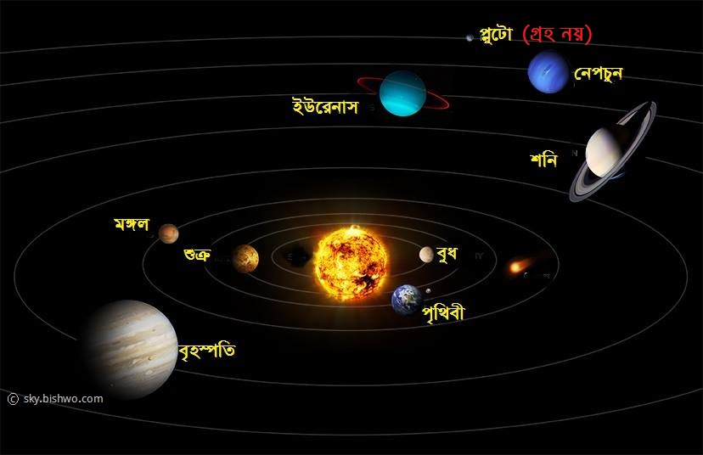
সৌরজগৎ

Slide 8
মূল্যায়নঃ
দয়া করে আপনারা করবেন।

Slide 9
বাড়ির কাজঃ
বাড়িতে গিয়ে চেষ্টা করব, ইনশা’আল্লাহ্।

Slide 10
ধন্যবাদ

